Slide 2
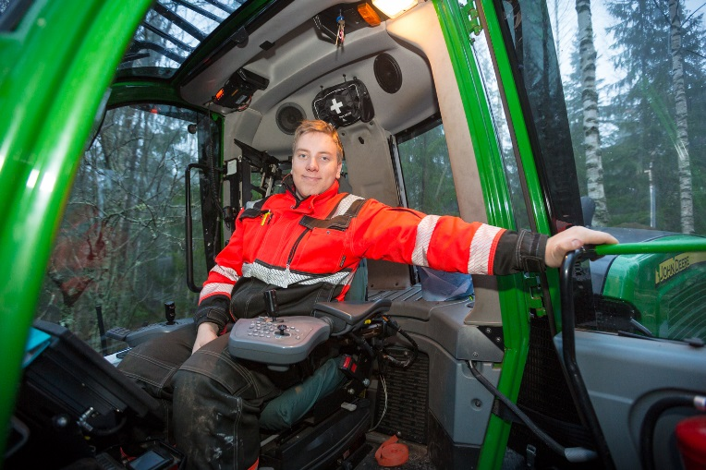
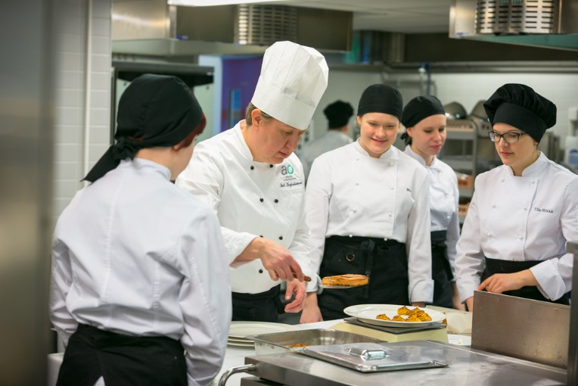
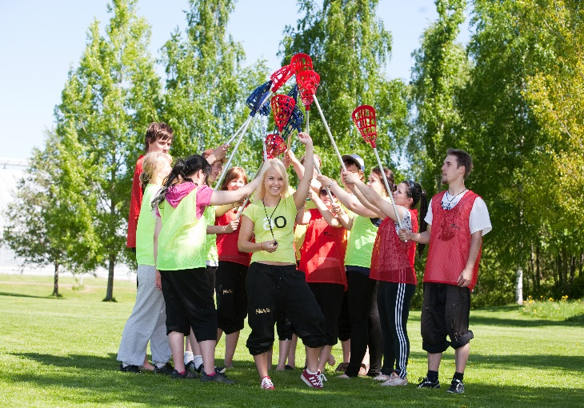
Jämsä College
a multidisciplinary educational institution that provides vocational education for both youth and adults.
a part of the Jyväskylä Educational Consortium, the fourth biggest VET provider in Finland.
contributes to the regional development in close cooperation with the working life and other educational institutions.
Is an important partner for the enterprises and organisations in Jämsä region –also an internationally active partner.

Slide 3
Jyväskylä Educational Consortium
Owner Municipalities
Council
Audit Committee
Board of Directors
CEO Vesa Saarikoski
Jyväskylä Institute of Adult Education
Jyväskylä
College
Jämsä
College
Jyväskylä General Upper Secondary Schools
Jyväskylä Apprenticeship Training Center
Real Estate Management
Group Management

Slide 4
Organisation of Jämsä College 1.2.2016
Principal Petteri Järvinen
Financial Manager Marja-Liisa Kovanen
Fields of Study, Youth and Adult Education
Development Services
Head of Unit Ms Seija Kivelä
Social and Health Care, Leisure, Sports Programme Manager
Ms Pirjo Hannula
Forestry,
Construction Programme Manager
Mr Jarmo Nikkanen
Vehicle Technology and Logistics,
Laboratory and Process Industry,
Electrical Engineering, ICT
Programme Manager
Mr Antti Rovasalo
Horticulture,
Nature and Environment, Business and Services,
Restaurant and Catering,
Tourism Industry
Programme Manager
Ms Sirpa Laakso
Metalwork and Machinery, Plastics and Rubber Technology Programme Manager
Mr Seppo Savo
Adult Education Coordination
Programme Manager Ms Tuula Rintala-Salminen
Support Services
Head of Unit Mr Petteri Järvinen
Student Services and Core Studies,
Preparatory Education for
Vocational Training
Programme Manager Mr Ari Porki
Sports Coaching
Coaching Manager Mr Seppo Savo

Slide 5
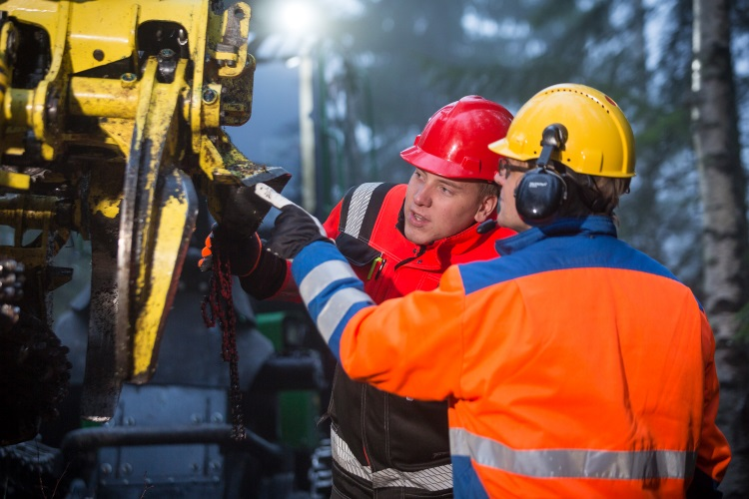
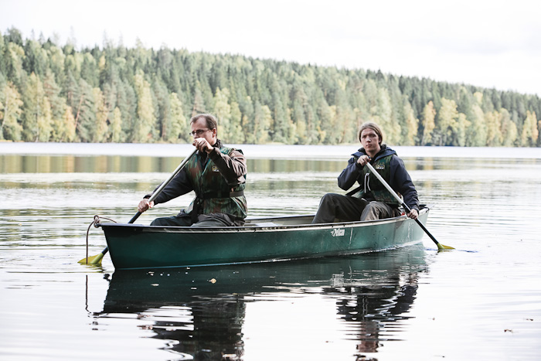
Young And Adult Learners
Vocational Qualifications
Social Services and Healthcare
Youth and Leisure Instruction
Horticulture
Forestry
Tourism Industry
Hotel, Restaurant and Catering Services
Social Sciences, Business and Administration
ICT
Metalwork and Machinery
Electrical Engineering
Plastics and Rubber Technology
Laboratory Technology
Process Technology
Vehicle Technology and Logistics
Construction
Further Vocational Qualifications (22)
Specialist Vocational Qualifications (4)
Apprenticeship Training

Slide 6
Key Indicators 2015
Number of competence-based qualifications (full qualifications) | 84
Number of students in
Vocational upper secondary qualifications | 1193
Further and specialist vocational qualifications | 324
Short courses | 600
Labour market training | 138
Preparatory Education for Vocational Training | 5
Number of personnel | 148
Annual turnover EUR | 16,6 million

Slide 7
Mission of Vocational Education
To enhance provincial and regional development
To develop business, industry and the public sector
To provide individual learning paths for young and adults
Provincial Development Strategy
Notes:
7

Slide 8
Strengths of Jämsä College
Providing vocational education and training (VET) for all students of all ages
VET education in various fields
VET programmes for young athletes (Finnish OC)
Team teaching and learning, project-based learning (PBL)
Management and implementation of development projects
Emphasis on entrepreneurship and internationalisation
Cooperation with higher education
Strong links with local industries

Slide 9
International Focus
The international co-operation between Jämsä College and its partner institutions is aimed at enhancing student and staff mobility.
The students are encouraged to do their on-the-job training periods abroad.
Students from the partner institutions are warmly welcome to follow the daily studies of our students.
As a unit of Jyväskylä Educational Consortium, Jämsä College is co-operating with EduCluster Finland (ECF) in the field of international operations.
New partners are constantly sought to join our international mobility and partnership projects.

Slide 10
Three-Level Internationalisation Model

Slide 11
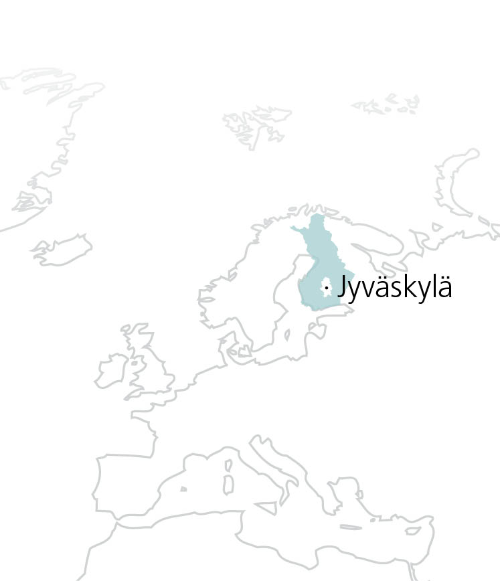
Location
Central Finland
Area 1 466,5 km²
Population
Jyväskylä 133 000
Jämsä 22 350 (2012)
Central Finland 275 100
Enterprises 14 400
Jobs 112 400
Notes:
3
3

Slide 12
Vocational Youth Education and Training

Slide 13
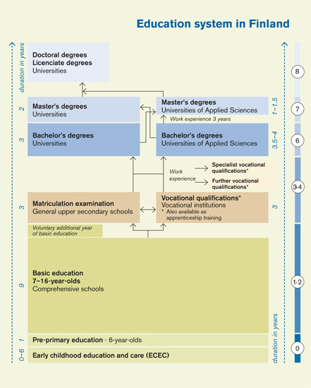
Education System in Finland

Slide 14
Vocational Upper Secondary Qualification
180 cp (3 years)
Vocational studies
135 cp
Core studies
35 cp (*)
Free-choice studies
10 cp (*)
Obligatory studies
Optional studies
The studies include:
• On-the-job Learning
• Final Project
• Entrepreneurship Studies
Other optional studies
• Entrepreneurship Studies
• Workplace Instructor Training
• Upper Secondary Studies
• Advanced Special Vocational Studies
Studies in Communication and Interpersonal Relations
Studies in Mathematics and Natural Sciences
Social, Business and Working Life Studies
Social and Cultural Studies
Elective studies
Vocational studies
Work experience
General studies or upper secondary studies
Supervised leisure activities
The studies marked with an asterisk (*) are implemented also in the studies towards a dual degree

Slide 15
Individual Study Paths
The students of Jämsä College are able to focus their studies in many ways, e.g.
Vocational education programmes for young athletes – vocational studies combined with training programmes
Dual or triple degrees: vocational + vocational; vocational + matriculation examination (+ full general upper secondary)
Entrepreneurship, starting one’s own company during studies
International and cultural studies
On-the-job learning – also international
World-class skills training (skills competitions)
Project studies commissioned by companies
The students are also able to enhance and expand their vocational skills by including studies from other vocational qualifications in their study programme.

Slide 16
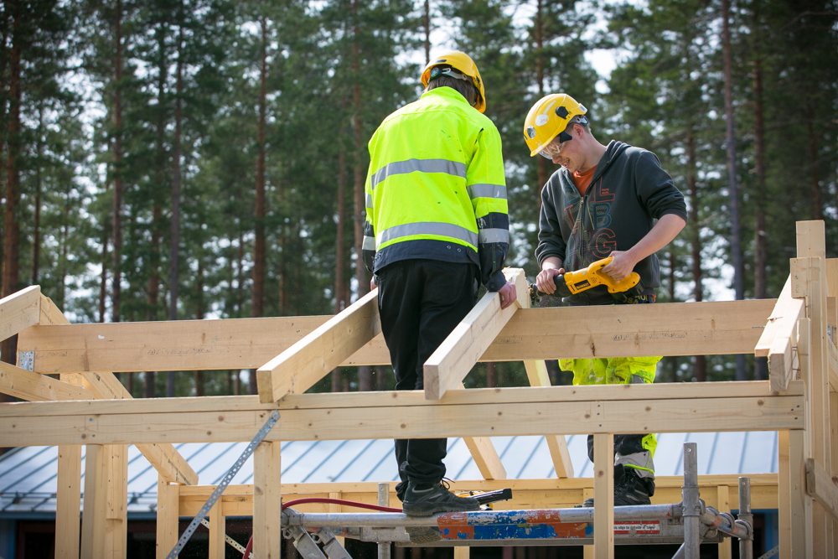
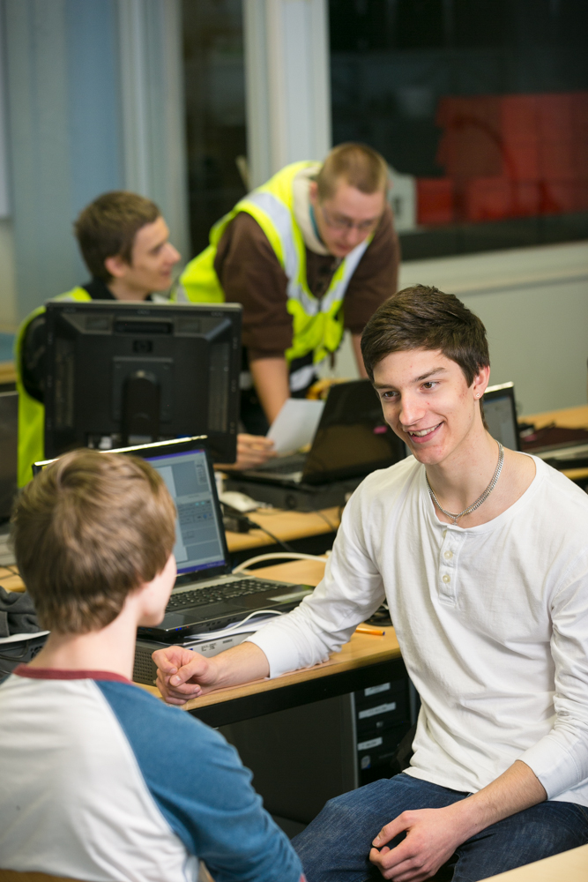
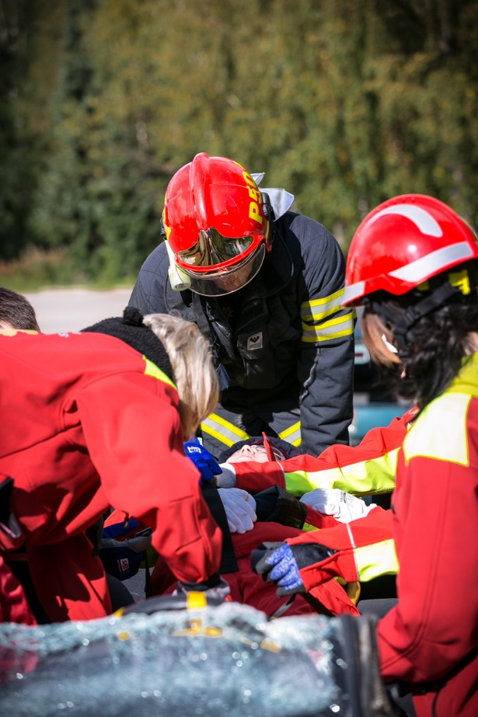
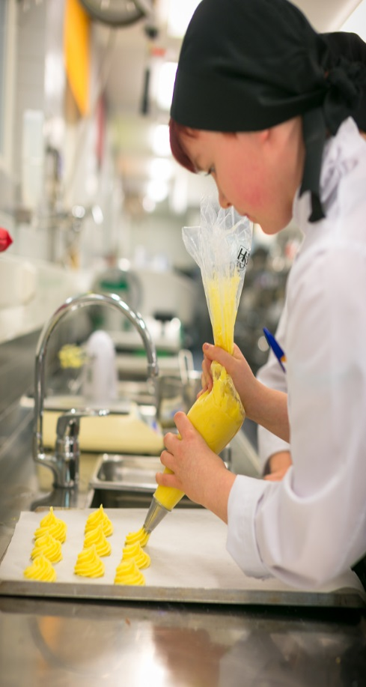

Slide 17
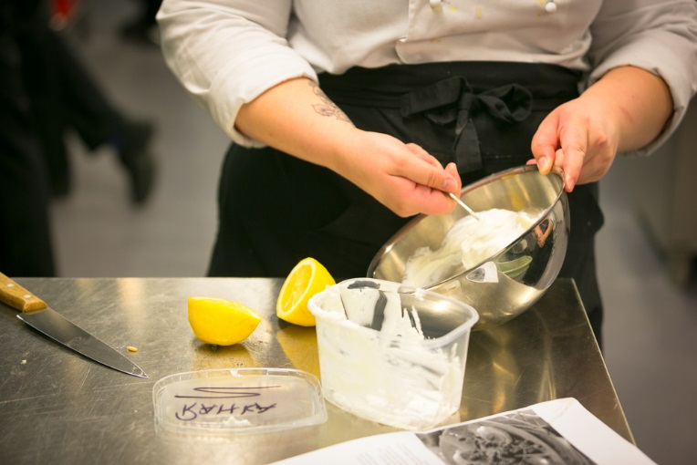
Entrepreneurship Studies
Entrepreneurship studies are aimed at enhancing the entrepreneurial way of thinking, continuous learning and self-development.
Entrepreneurship studies can be carried out flexibly according to each student’s individual learning paths.
Basics of entrepreneurship studies are included in all vocational upper secondary qualifications
Entrepreneurship is one of the central strategic focuses of the Jyväskylä Educational Consortium

Slide 18
Student Assessment
Each vocational qualification has its own core curriculum as well as competence based qualification criteria, and all the vocational institutes in Finland comply with them.
They describe the competence criteria, assessment items, as well as the criteria and modes of vocational skills demonstrations for each stage and area of the qualification concerned.
Both learning and learning outcomes (skills, knowledge and competences) are assessed.
Continuous assessment as a tool of learning: the students are continually given oral and written feedback on their progress. The aim of the feedback is to guide the students towards the required skills and competences. It does not affect grading.
The assessment of learning outcomes: final vocational skills, knowledge and competences are assessed on the basis of vocational skills demonstrations and other forms of assessment.
Grading Scale: 1 = satisfactory, 2 = good, 3 = excellent

Slide 19
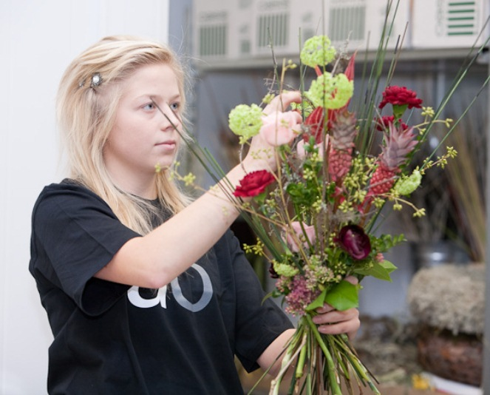
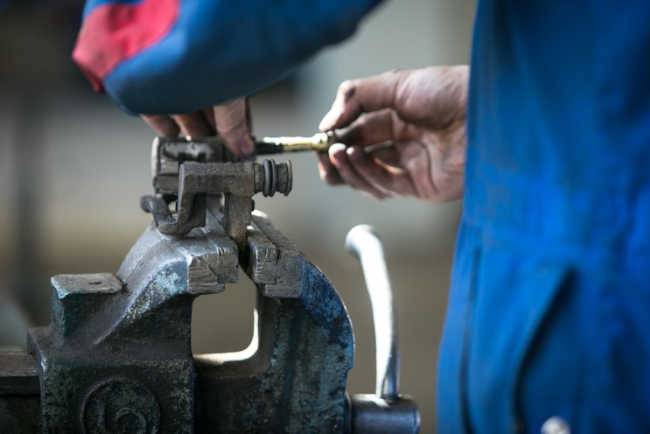
Vocational Skills Demonstrations
All the areas of the vocational qualification are assessed in vocational skills demonstrations.
Mainly during the on-the-job learning periods (practical training in working life, learning one’s profession).
In normal work tasks .
The grade is given by the teacher and the work place supervisor or other representative of the working life.
Is truly a work-based assessment of the competence and learning outcomes of the student.
The whole section of curriculum is covered.

Slide 20
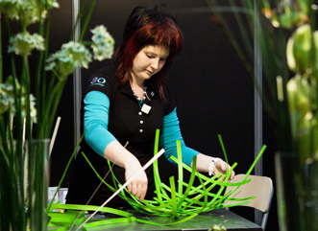
Competition Activities
The Jyväskylä Educational Consortium supports the participation of its students in national and international competitions.
Dozens of talented students are coached and prepared for skills competitions every year.
Success record of Jämsä College in National and International Skills Competitions in Floristry:
WorldSkills in Leipzig 2013: Bronze Medal
Finnish Championships Final 2012: double victory in Floristry, representative of Finland for WorldSkills
EuroSkills in Belgium in 2012: sixth
WorldSkills in London in 2011: Bronze Medal
Jämsä College has been successful in WordsSkills in Floristry winning bronze in London 2011 (Jenniina Tiikkainen above) and in Leipzig 2013.

Slide 21
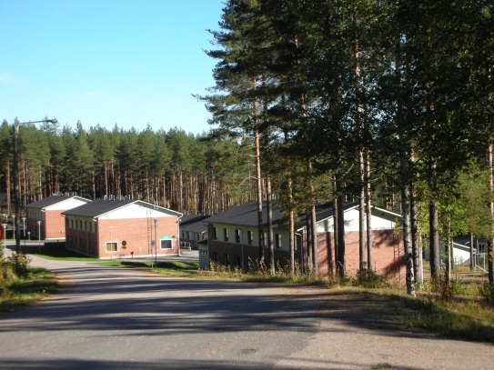
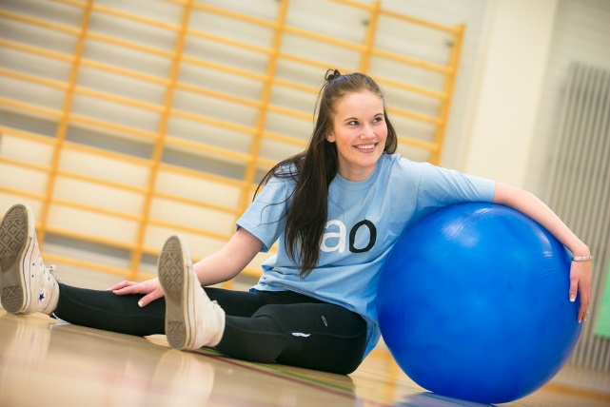
Support and Student Services
Study counselling
Special education and special needs
Student welfare
Student health care services
Support of studies and career choices
Supplementary studies towards completing basic education and for improving one’s basic education certificate grades
Career Start Programme to support and prepare school leavers for vocational studies
Student restaurants
Library
Leisure activities
Student accommodation: residence halls

Slide 22
Kuvasivu
Vocational Adult Education

Slide 23
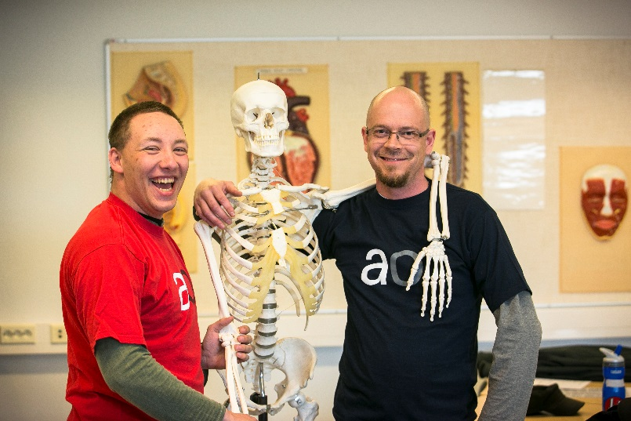
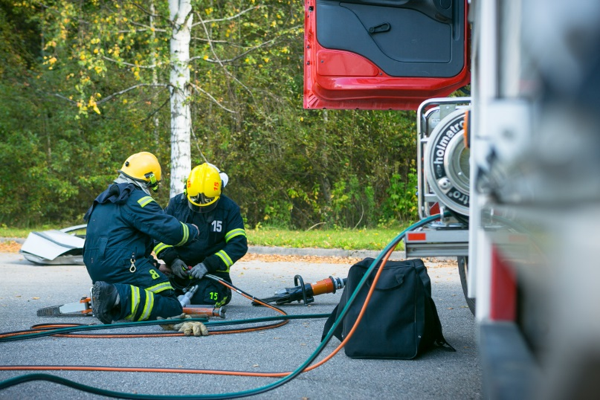
Vocational Adult Education
Adult education is planned and developed together with working life
It is a possibility for the education provider and the students to answer and learn for the present needs of working life.
Jämsä College
offers forestry education directed esp. for women on the Study Programme in Forest Machine Operator.
has developed and initiated the first Specialist Qualification in Handicrafts specialising in restoration of antique vehicles.

Slide 24
Vocational Adult Education – Competence-based Qualifications
The competence-based qualification system is specially designed for adults. It has been successfully implemented for over ten years.
A total of 52 different vocational upper secondary qualifications and more than 300 further vocational qualifications and specialist vocational qualifications can be completed in the system nationwide.
Business, industry and the public sector are active partners in the implementation and development of competence-based qualifications.

Slide 25
Competence Demonstrations
In vocational adult education, competence-based qualification is a flexible way to maintain and update one’s competence.
The focus is on competence demonstrations, which give skilled workers an opportunity to obtain a competence-based qualification.
The skills are demonstrated in authentic work situations via competence demonstrations.
The system allows the student to be credited for previously acquired competence no matter, where or how it has been gained.
Skills, knowledge and competence are assessed to cover all the areas of vocational qualification.

Slide 26
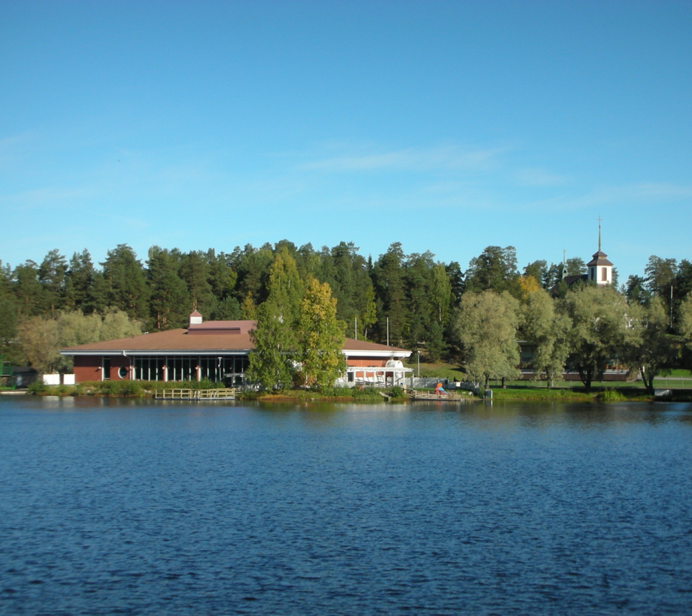
Welcome to Jämsä Region!
Photos: Maria Sissonen and the Department of Forestry

Slide 27
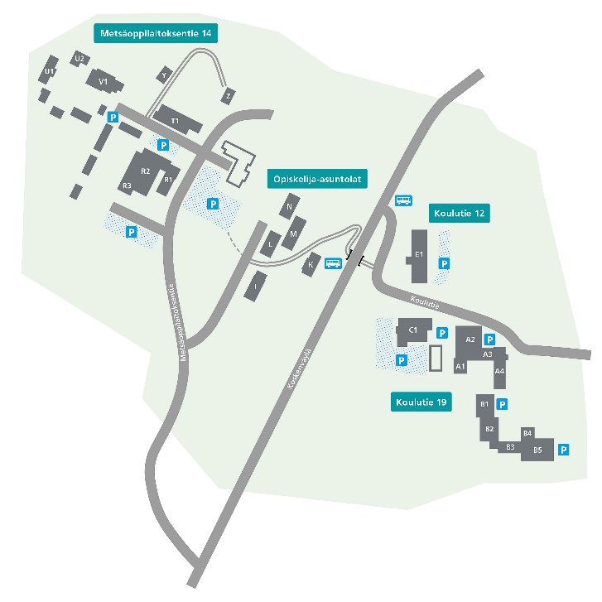
Jämsä College - Myllymäki Campuses
Metsäoppilaitoksentie 14
Department of Forestry
Department of
Logistics
Department of Horticulture, Nature and the Environment
Horticulture, Floristry
Nature and the Environment
Construction
Koulutie 12
Department of Social and Health Care,
Humanities and Education
Humanities and Education: Leisure
Guidance
Social Services, Health Care
Koulutie 19
Administration
Student Services
Student cafeteria/restaurant and gym
Department of Business and Services
Catering and Domestic Services
Business and Administration
Tourism Industry
Department of Technology and Industry
Metalwork and Machinery
Electrical Engineering and Automation
Plastics and Rubber Technology
Process Industry
Laboratory Technology
Process Technology

Slide 28
International Relations
International Affairs :
Mr Ari Salmela, Programme Manager, ari.salmela@jao.fi
Department of Business and Services
Ms. Sirpa Laakso, Programme Manager
Ms. Sari Lehtonotko, Teacher, Mobility Liaison
Department of Social and Health Care, Humanities and Education
Ms. Pirjo Hannula, Programme Manager
Ms. Maria Sissonen, Teacher, Mobility Liaison (Social and Health Care)
Ms. Pia Luukkonen, Teacher, Mobility Liaison (Leisure and Sports)
Department of Horticulture, Nature and the Environment
Ms. Sirpa Laakso, Programme Manager
Mr. Jari Järvenranta, Teacher, Mobility Liaison

Slide 29
International Relations
Department of Forestry and Construction
Mr. Jarmo Nikkanen, Programme Manager
Mr. Kari Kytömäki, Teacher, Mobility Liaison
Department of Metalworks and Machinery, Plastics and Rubber Technology
Mr. Seppo Savo, Programme Manager
Ms. Sari Lehtonotko, Teacher, Mobility Liaison
Department of Vehicle Technology and Logistics, Process Industry, Electrical Engineering and ICT
Mr. Antti Rovasalo, Programme Manager
Ms. Sari Lehtonotko, Teacher, Mobility Liaison

Slide 30
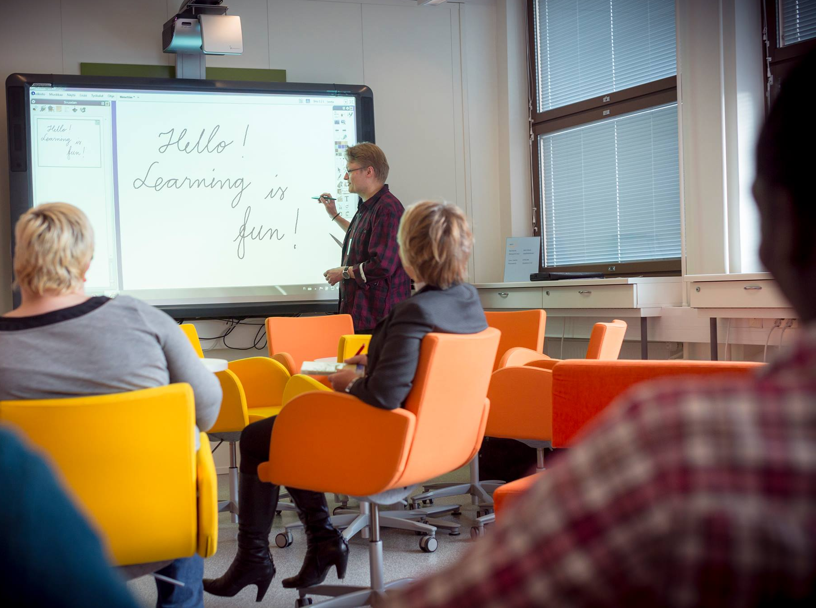
Thank you!
Contact information
P.O. Box 24 FI-42301 Jämsänkoski Tel. +358 40 341 5111 firstname.surname@jao.fi international@jao.fi

